Slide 1
Object Oriented Programming Lab CSE 1206

Slide 2
Course Teacher Dr. Shahriar Mahbub, Professor
Nibir Chandra Mandal, Lecturer Nowshin Nawar Arony, Lecturer

Slide 3
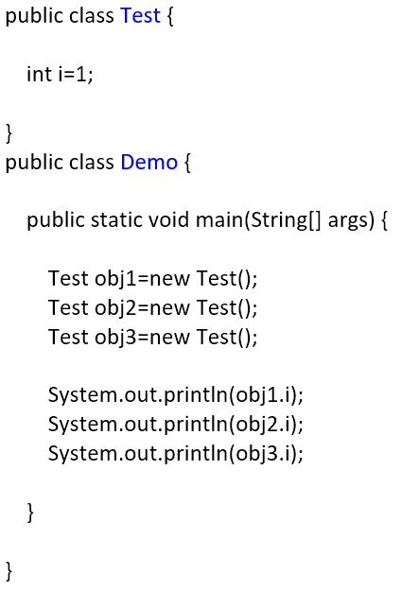
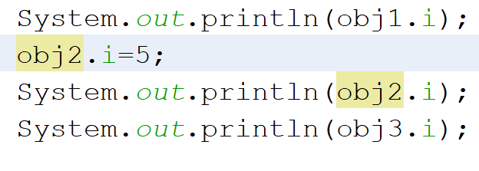
Variables
Obj2
i=5
Obj1
i=1
Obj2
i=1
Obj3
i=1
Each variable is exclusive to its own object. One object cannot access or modify another object’s variables normally.

Slide 4
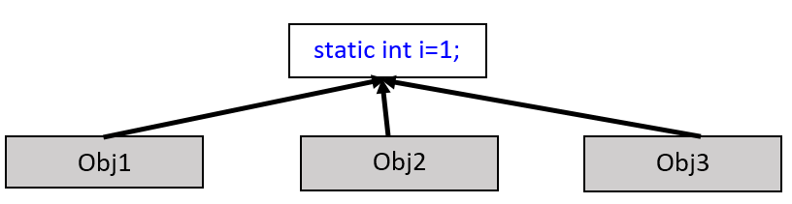
Static Variables:
When a variable is declared static, it has a permanent place in the memory.
All objects have access to that common static variable.
Value of static variable can be changed. Once changed it is permanently changed for all objects.

Slide 5

Static Variables
Obj1
Output:
1
5
5
i=5
i=1
Obj2
Obj3

Slide 6
Methods
public void printName(String name){
System.out.println(name);
}
Methods when created are generally stored in permanent memory
instance Methods (normal) | static methods
Every object has its own copy of method. | Method shared among all objects.

Slide 7
static methods
A static method belongs to the class rather than the object of a class.
A static method can access static data member and can change the value of it.
A static method can be called without the need for creating an instance of a class.

Slide 8
Project Name: TestEmployee (main class)
Class Name: Employee
Variables in Employee:
static String organization;
private int eid;
private String name;
private String designation;
private int age;

Slide 9
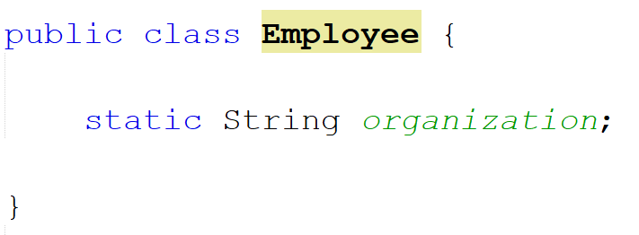
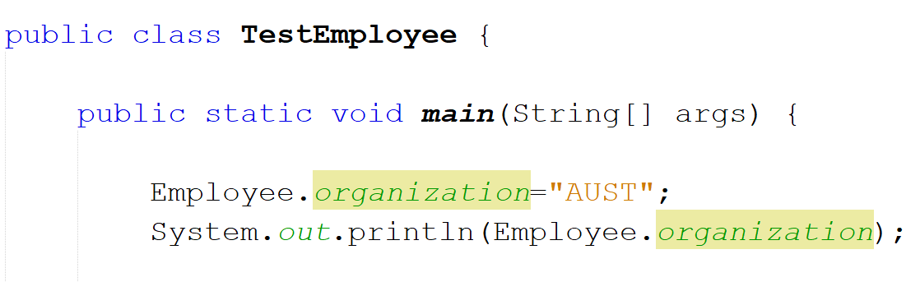

Slide 10
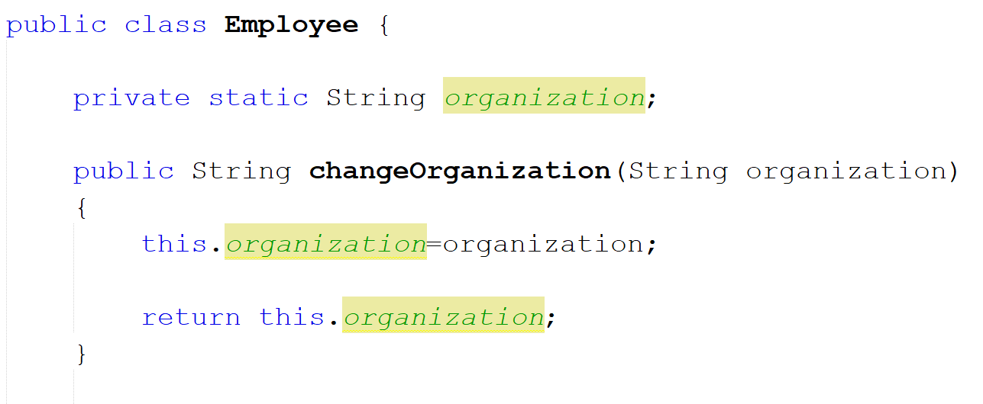

Slide 11
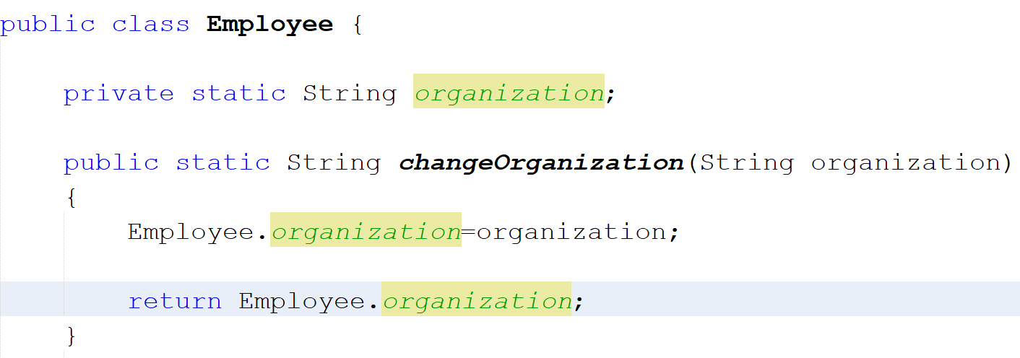
Usually static methods are used to change static variables

Slide 12
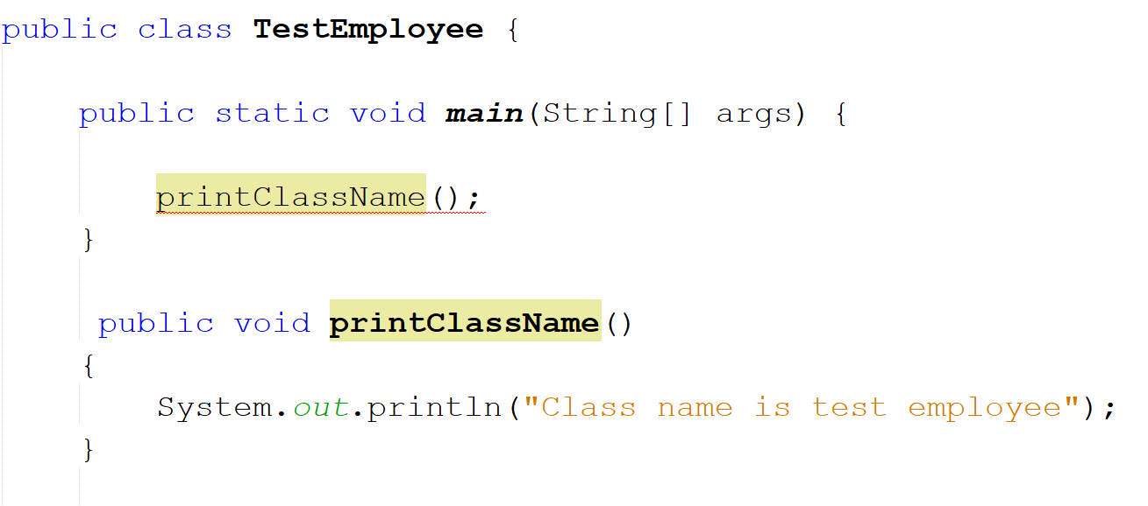
Calling methods in Main method
Giving an error.

Slide 13
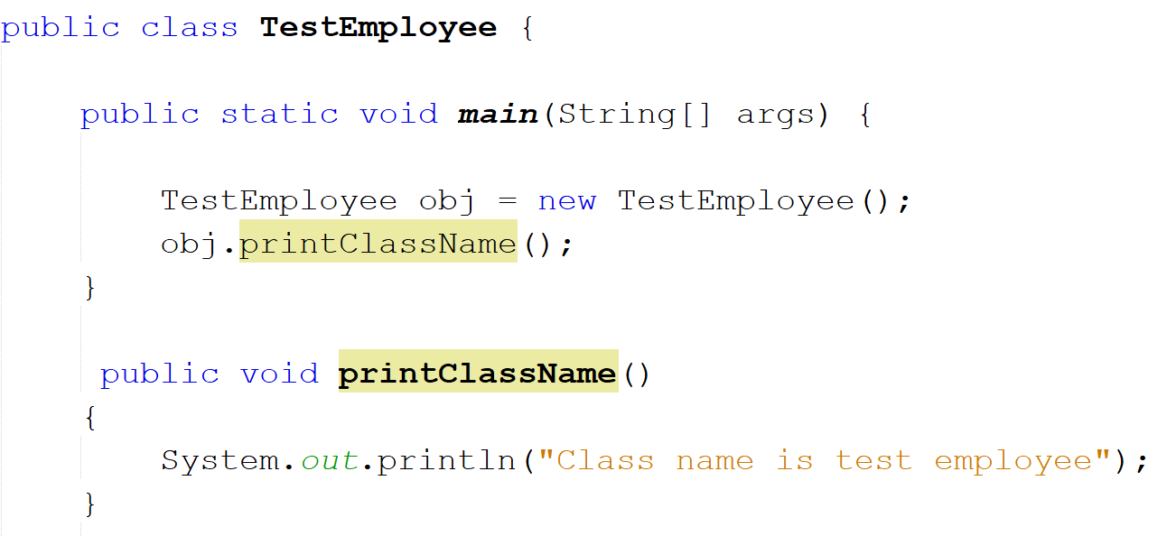
You will need to create object

Slide 14
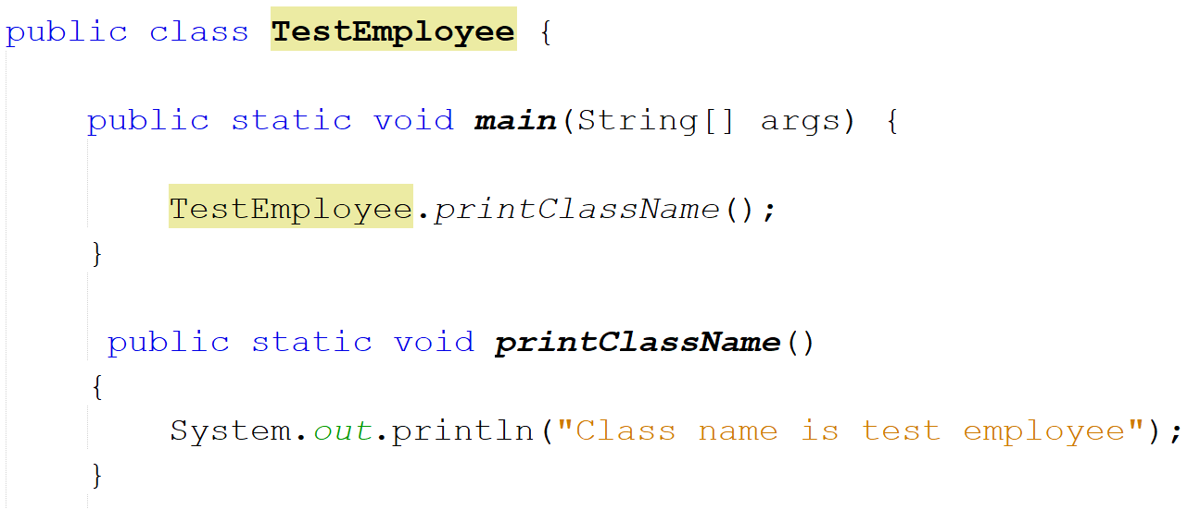
Or you can make the method static

Slide 15
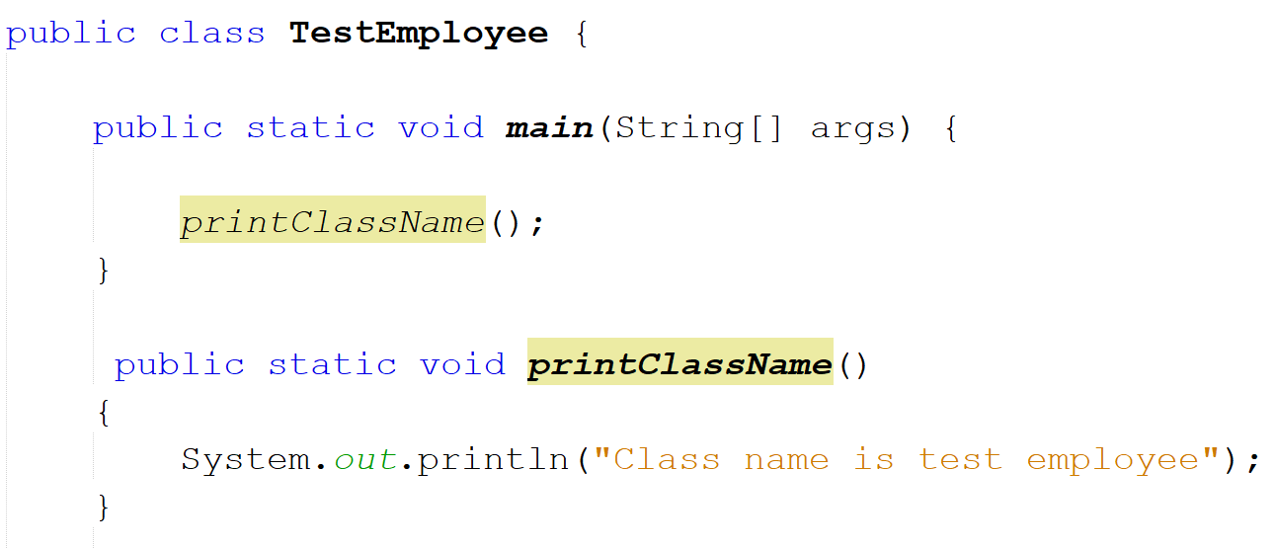
Or call it directly without the Class name

Slide 16
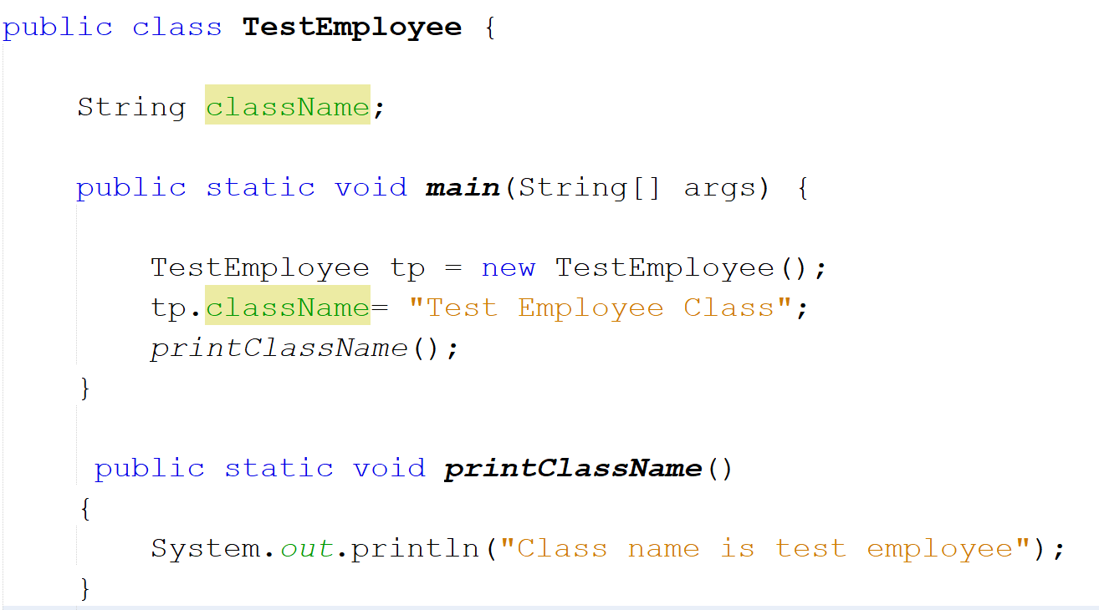
Similar case for variables

Slide 17
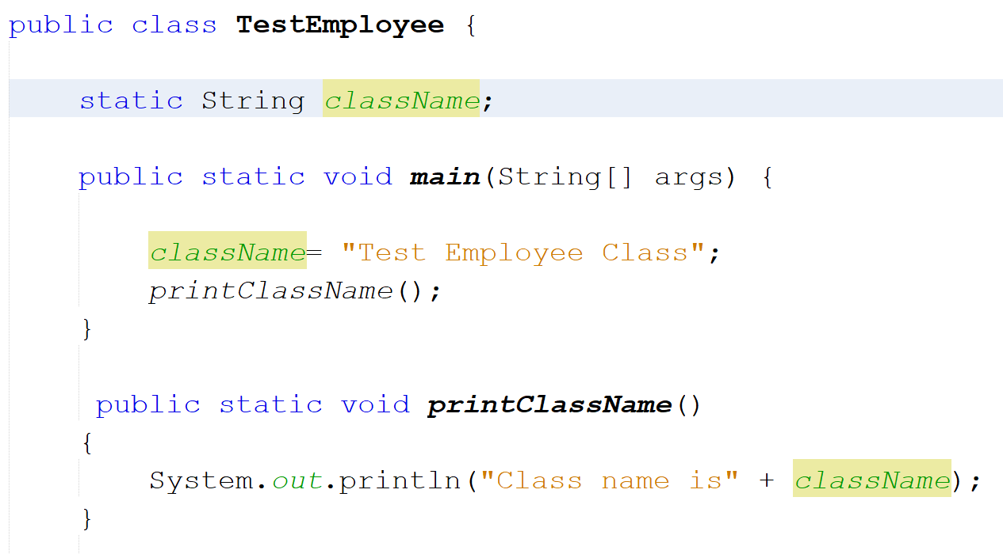
Or declare the variable static

Slide 18
Introduction to Inheritance

Slide 19
Inheritance in Java is a mechanism in which one object acquires all the properties and behaviors of a parent object.

Slide 20
Inheritance
Class that is inherited is called SUPERCLASS
Class that does the inheriting is called SUBCLASS
Syntax: using extends keyword
class Subclass-name extends Superclass-name
{
//methods and fields
}

Slide 21
Single Level Inheritance

Slide 22
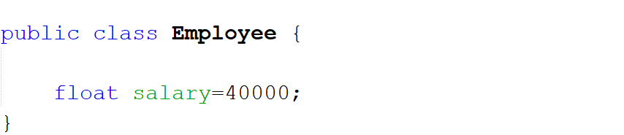
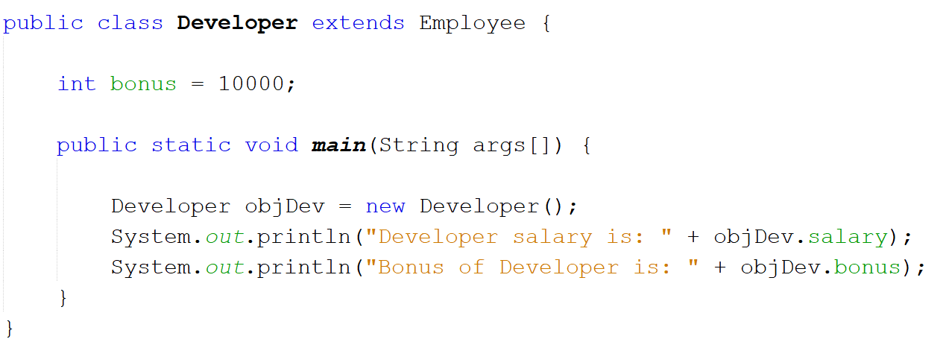
Super Class
Sub Class

Slide 23
Create a project with whatever name you want to. It will be the main class. Then create the following inheritance.

Slide 24
Super Class Name: Shape
Variables: color (String), filled (Boolean) Two constructors: - a no-argument constructor that initializes color =“white” and filled = true - parameterized constructor.
Sub Class Name: Circle
Variables: radius (double) Three constructors: a no-argument constructor that initializes the radius = 1.0 A parameterized constructor with only radius as parameter. - Another parameterized constructor with radius, color and filled

Slide 25
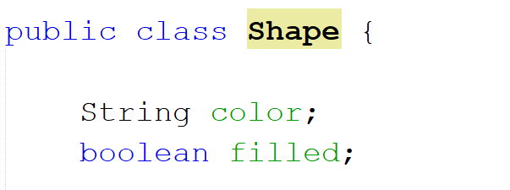
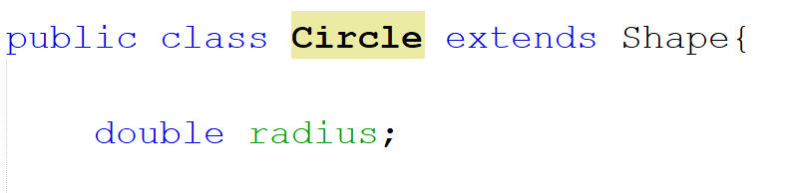
Super Class
Sub Class

Slide 26
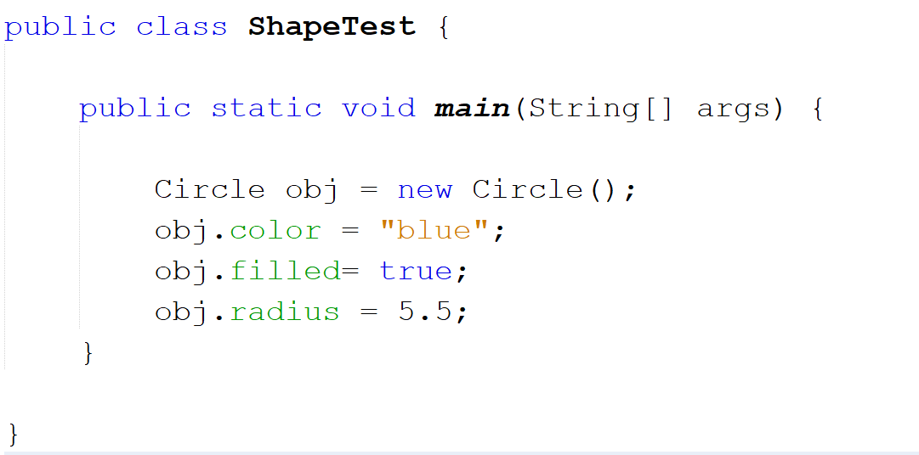
Testing the Inheritance in Main Class

Slide 27
Hierarchical Inheritance

Slide 28
Super Class : Shape
Sub Class Name: Rectangle
Variables: length (double), width (double) Three constructors: a no-argument constructor that initializes the length = 1.0, width = 1.0 A parameterized constructor with only length, width as parameter. - Another parameterized constructor with length, width, color and filled

Slide 29
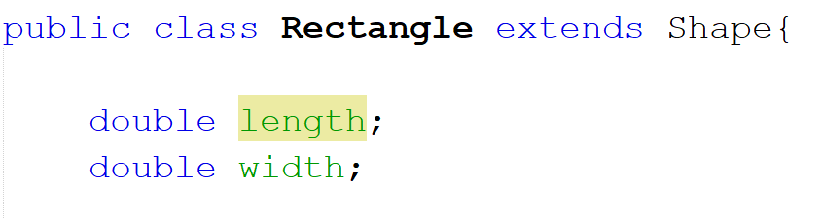
Sub Class 2 of Super Class Shape

Slide 30
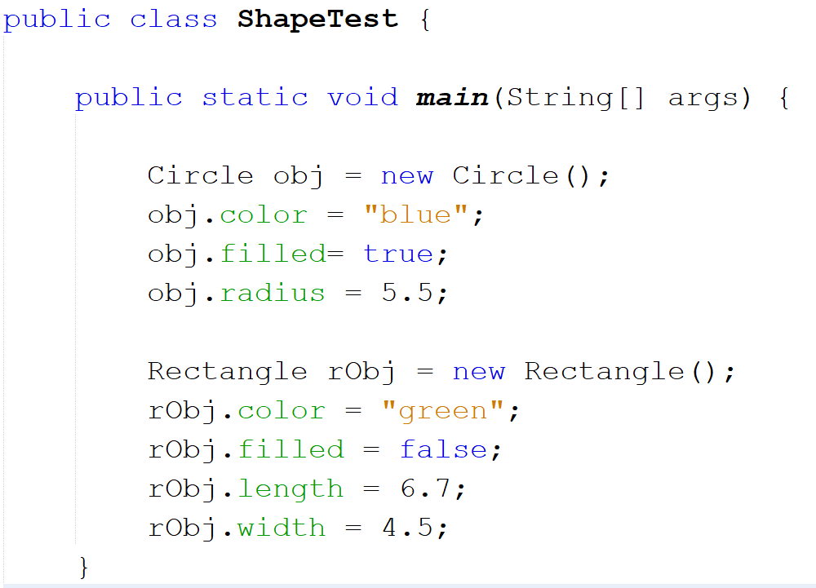

Slide 31
Multilevel Inheritance

Slide 32
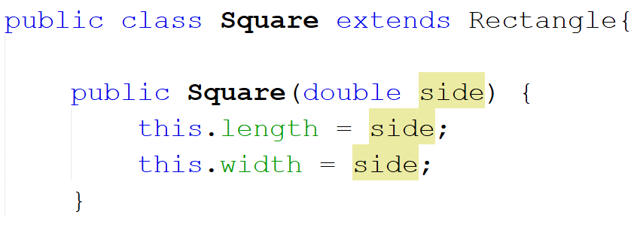

Slide 33
